Slide 1
What is Clustering?
Also called unsupervised learning, sometimes called classification by statisticians and sorting by psychologists and segmentation by people in marketing
Objective: Organizing data into classes such that there is
high intra-class (within cluster) similarity
low inter-class (between cluster) similarity
Finding the class labels and the number of classes directly from the data (in contrast to classification).
More informally, finding natural groupings among objects.
Used for business analytics and recommendation system

Slide 2
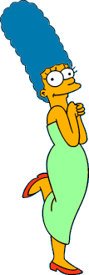



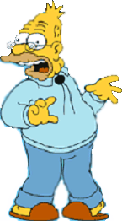
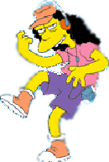


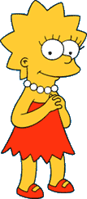
What is a natural grouping among these objects?

Slide 3
What is a natural grouping among these objects?
Clustering is subjective
Simpson's Family
School Employees
Females
Males

Slide 4
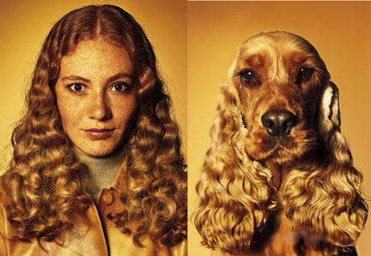
What is Similarity?
The quality or state of being similar; likeness; resemblance; as, a similarity of features.
Webster's Dictionary
Similarity is hard to define, but…
“We know it when we see it”
The real meaning of similarity is a philosophical question. We will take a more pragmatic approach.

Slide 5
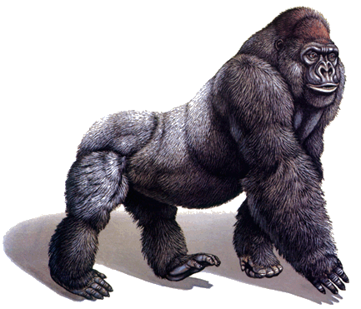
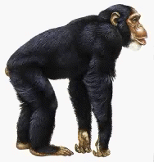
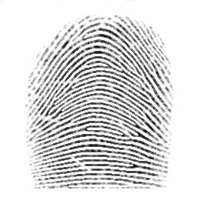
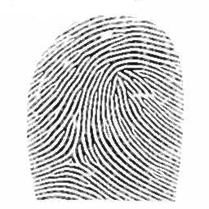
Defining Distance Measures
Definition: Let O₁ and O₂ be two objects from the universe of possible objects. The distance (dissimilarity) between O₁ and O₂ is a real number denoted by D(O₁,O₂)
Peter
Piotr
0.23
3
342.7

Slide 6
Peter
Piotr
When we peek inside one of these black boxes, we see some function on two variables. These functions might very simple or very complex.
In either case it is natural to ask, what properties should these functions have?
d('', '') = 0 d(s, '') = d('', s) = |s| -- i.e. length of s d(s1+ch1, s2+ch2) = min( d(s1, s2) + if ch1=ch2 then 0 else 1 fi, d(s1+ch1, s2) + 1, d(s1, s2+ch2) + 1 )
3
What properties should a distance measure have?
D(A,B) = D(B,A) Symmetry
D(A,A) = 0 Constancy of Self-Similarity
D(A,B) = 0 If A= B Positivity (Separation)
D(A,B) ≤ D(A,C) + D(B,C) Triangular Inequality

Slide 7
Intuitions behind desirable distance measure properties
D(A,B) = D(B,A) Symmetry
Otherwise you could claim “Alex looks like Bob, but Bob looks nothing like Alex.”
D(A,A) = 0 Constancy of Self-Similarity
Otherwise you could claim “Alex looks more like Bob, than Bob does.”
D(A,B) = 0 If A=B Positivity (Separation)
Otherwise there are objects in your world that are different, but you cannot tell apart.
D(A,B) ≤ D(A,C) + D(B,C) Triangular Inequality
Otherwise you could claim “Alex is very like Bob, and Alex is very like Carl, but Bob is very unlike Carl.”

Slide 8


Two Types of Clustering
Partitional algorithms: Construct various partitions and then evaluate them by some criterion (non-ranked) (we will see an example called BIRCH)
Hierarchical algorithms: Create a hierarchical/ranked decomposition of the set of objects using some criterion
Form of a tree in this technique, and this tree-shaped structure is known as the dendrogram
Hierarchical
Partitional

Slide 9
Desirable Properties of a Clustering Algorithm
Scalability (in terms of both time and space)
Ability to deal with different data types
Minimal requirements for domain knowledge to determine input parameters
Able to deal with noise and outliers
Insensitive to order of input records
Incorporation of user-specified constraints
Interpretability and usability

Slide 10
A Useful Tool for Summarizing Similarity Measurements
In order to better appreciate and evaluate the examples given in the early part of this talk, we will now introduce the dendrogram.
The similarity between two objects in a dendrogram is represented as the height of the lowest internal node they share.

Slide 11
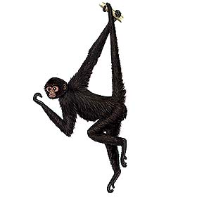
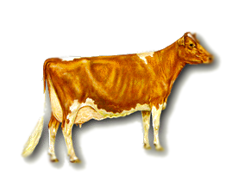
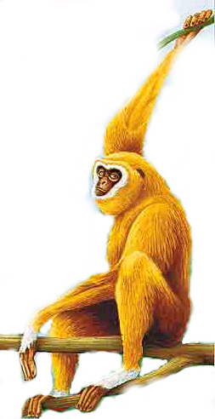
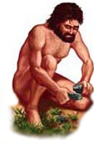
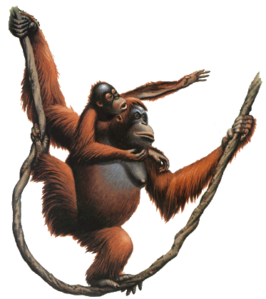
There is only one dataset that can be perfectly clustered using a hierarchy…
(Bovine:0.69395, (Spider Monkey 0.390, (Gibbon:0.36079,(Orang:0.33636,(Gorilla:0.17147,(Chimp:0.19268, Human:0.11927):0.08386):0.06124):0.15057):0.54939);

Slide 12

Note that hierarchies are commonly used to organize information, for example in a web portal.
Yahoo’s hierarchy is manually created, we will focus on automatic creation of hierarchies in data mining.
Business & Economy
B2B Finance Shopping Jobs
Aerospace Agriculture… Banking Bonds… Animals Apparel Career Workspace

Slide 13
A Demonstration of Hierarchical Clustering using String Edit Distance
Pedro (Portuguese)
Petros (Greek), Peter (English), Piotr (Polish), Peadar (Irish), Pierre (French), Peder (Danish), Peka (Hawaiian), Pietro (Italian), Piero (Italian Alternative), Petr (Czech), Pyotr (Russian)
Cristovao (Portuguese)
Christoph (German), Christophe (French), Cristobal (Spanish), Cristoforo (Italian), Kristoffer (Scandinavian), Krystof (Czech), Christopher (English)
Miguel (Portuguese)
Michalis (Greek), Michael (English), Mick (Irish!)
Piotr
Pedro
Piero
Peter
Peka
Mick
Pyotr
Pietro
Pierre
Peder
Petros
Peadar
Miguel
Krystof
Michael
Michalis
Crisdean
Cristovao
Christoph
Cristobal
Kristoffer
Christophe
Cristoforo
Christopher

Slide 14
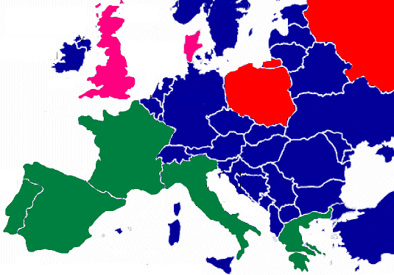
Pedro (Portuguese/Spanish)
Petros (Greek), Peter (English), Piotr (Polish), Peadar (Irish), Pierre (French), Peder (Danish), Peka (Hawaiian), Pietro (Italian), Piero (Italian Alternative), Petr (Czech), Pyotr (Russian)
Piotr
Pedro
Piero
Peter
Peka
Pyotr
Pietro
Pierre
Peder
Petros
Peadar

Slide 15











Hierarchal clustering can sometimes show patterns that are meaningless or spurious
For example, in this clustering, the tight grouping of Australia, Anguilla, St. Helena etc is meaningful, since all these countries are former UK colonies.
However the tight grouping of Niger and India is completely spurious, there is no connection between the two.
South Georgia &
South Sandwich
Islands
Serbia &
Montenegro
(Yugoslavia)
AUSTRALIA
St. Helena &
Dependencies
ANGUILLA
U.K.
FRANCE
NIGER
INDIA
IRELAND
BRAZIL

Slide 16
The flag of Niger is orange over white over green, with an orange disc on the central white stripe, symbolizing the sun. The orange stands the Sahara desert, which borders Niger to the north. Green stands for the grassy plains of the south and west and for the River Niger which sustains them. It also stands for fraternity and hope. White generally symbolizes purity and hope.
The Indian flag is a horizontal tricolor in equal proportion of deep saffron on the top, white in the middle and dark green at the bottom. In the center of the white band, there is a wheel in navy blue to indicate the Dharma Chakra, the wheel of law in the Sarnath Lion Capital. This center symbol or the 'CHAKRA' is a symbol dating back to 2nd century BC. The saffron stands for courage and sacrifice; the white, for purity and truth; the green for growth and auspiciousness.
South Georgia &
South Sandwich
Islands
Serbia &
Montenegro
(Yugoslavia)
AUSTRALIA
St. Helena &
Dependencies
ANGUILLA
U.K.
FRANCE
NIGER
INDIA
IRELAND
BRAZIL

Slide 17
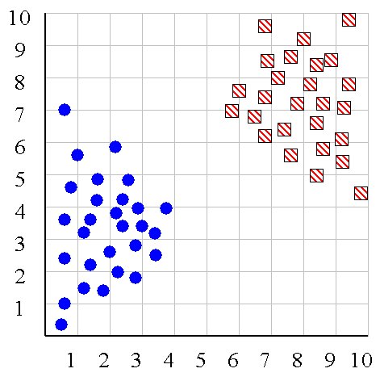
We can look at the dendrogram to determine the “correct” number of clusters. In this case, the two highly separated subtrees are highly suggestive of two clusters. (Things are rarely this clear cut, unfortunately)

Slide 18
One potential use of a dendrogram is to detect outliers
The single isolated branch is suggestive of a data point that is very different to all others
Outlier

Slide 19
(How-to) Hierarchical Clustering
The number of dendrograms with n leafs = (2n -3)!/[(2^{(n -2)}) (n -2)!]
Number Number of Possible
of Leafs Dendrograms
2 1
3 3
4 15
5 105
... …
34,459,425
Since we cannot test all possible trees we will have to heuristic search of all possible trees. We could do this..
Bottom-Up (agglomerative): Starting with each item in its own cluster, find the best pair to merge into a new cluster. Repeat until all clusters are fused together.
Top-Down (divisive): Starting with all the data in a single cluster, consider every possible way to divide the cluster into two. Choose the best division and recursively operate on both sides.

Slide 20


We begin with a distance matrix which contains the distances between every pair of objects in our database.
0
8
8
7
7
0
2
4
4
D( , ) = 8
D( , ) = 1
0
3
3
0
1
0

Slide 21
Bottom-Up (agglomerative): Starting with each item in its own cluster, find the best pair to merge into a new cluster. Repeat until all clusters are fused together.
Consider all possible merges…
Choose the best
…

Slide 22
Bottom-Up (agglomerative): Starting with each item in its own cluster, find the best pair to merge into a new cluster. Repeat until all clusters are fused together.
Consider all possible merges…
Choose the best
…
Consider all possible merges…
Choose the best
…

Slide 23
Bottom-Up (agglomerative): Starting with each item in its own cluster, find the best pair to merge into a new cluster. Repeat until all clusters are fused together.
Consider all possible merges…
Choose the best
…
Consider all possible merges…
Choose the best
…
Consider all possible merges…
Choose the best
…

Slide 24
Bottom-Up (agglomerative): Starting with each item in its own cluster, find the best pair to merge into a new cluster. Repeat until all clusters are fused together.
Consider all possible merges…
Choose the best
…
Consider all possible merges…
Choose the best
…
Consider all possible merges…
Choose the best
…

Slide 25
We know how to measure the distance between two objects, but defining the distance between an object and a cluster, or defining the distance between two clusters is non obvious.
Single linkage (nearest neighbor): In this method the distance between two clusters is determined by the distance of the two closest objects (nearest neighbors) in the different clusters.
Complete linkage (furthest neighbor): In this method, the distances between clusters are determined by the greatest distance between any two objects in the different clusters (i.e., by the "furthest neighbors").
Group average linkage: In this method, the distance between two clusters is calculated as the average distance between all pairs of objects in the two different clusters.
Wards Linkage: In this method, we try to minimize the variance of the merged clusters

Slide 26
Single linkage
Average linkage
Wards linkage

Slide 27
Summary of Hierarchal Clustering Methods
No need to specify the number of clusters in advance.
Hierarchal nature maps nicely onto human intuition for some domains
They do not scale well: time complexity of at least O(n²), where n is the number of total objects.
Like any heuristic search algorithms, local optima are a problem.
Interpretation of results is (very) subjective.

Slide 28
Up to this point we have simply assumed that we can measure similarity, but How do we measure similarity?
Peter
Piotr
0.23
3
342.7

Slide 29
A generic technique for measuring similarity
To measure the similarity between two objects, transform one of the objects into the other, and measure how much effort it took. The measure of effort becomes the distance measure.
The distance between Patty and Selma.
Change dress color, 1 point
Change earring shape, 1 point
Change hair part, 1 point
D(Patty,Selma) = 3
The distance between Marge and Selma.
Change dress color, 1 point
Add earrings, 1 point
Decrease height, 1 point
Take up smoking, 1 point
Lose weight, 1 point
D(Marge,Selma) = 5
This is called the “edit distance” or the “transformation distance”

Slide 30
Edit Distance Example
How similar are the names “Peter” and “Piotr”?
Assume the following cost function
Substitution 1 Unit
Insertion 1 Unit
Deletion 1 Unit
D(Peter,Piotr) is 3
It is possible to transform any string Q into string C, using only Substitution, Insertion and Deletion.
Assume that each of these operators has a cost associated with it.
The similarity between two strings can be defined as the cost of the cheapest transformation from Q to C.
Note that for now we have ignored the issue of how we can find this cheapest transformation
Peter
Piter
Pioter
Piotr
Substitution (i for e)
Insertion (o)
Piotr
Pedro
Piero
Peter
Deletion (e)
Pyotr
Petros
Pietro
Pierre

Slide 31
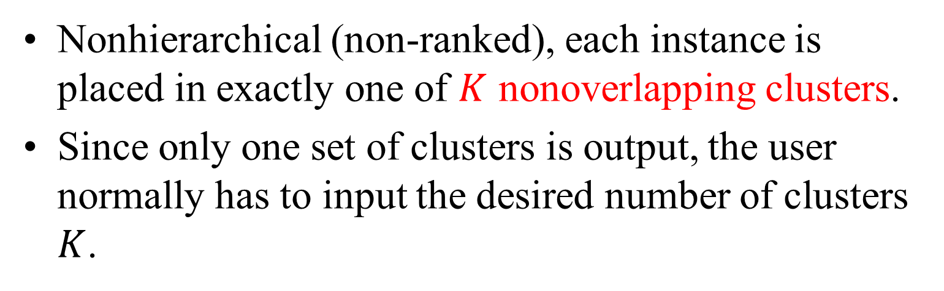
Partitional Clustering
Nonhierarchical (non-ranked), each instance is placed in exactly one of $K$ nonoverlapping clusters.
Since only one set of clusters is output, the user normally has to input the desired number of clusters $K$.

Slide 32
Algorithm k-means clustering
Decide on a value for k = # of clusters: Hyperparameter
2. Initialize the k cluster centers/centroids (randomly based on an empirical probability distribution of the points).
3. Decide the class memberships of the N objects by assigning them to the nearest cluster center.
4. Re-estimate/Update the k cluster centers, by assuming the memberships found above are correct by measuring the mean position/coordinate of the data samples.
5. If none of the N objects changed membership in the last iteration, exit. Otherwise go to 3.

Slide 33
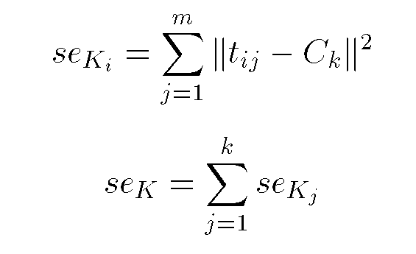
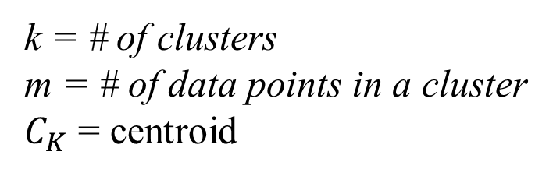
Squared Error
k = # of clusters
m = # of data points in a cluster
$C_{K}$ = centroid
10
9
8
7
6
5
4
3
2
1
1
2
3
4
5
6
7
8
9
10
Objective Function: Total squared error

Slide 34
K-means Clustering: Step 1
Algorithm: k-means, Distance Metric: Euclidean Distance
5
4
k₁
3
k₂
2
1
k₃
0
0
1
2
3
4
5
Initialize the k cluster centers/centroids (randomly based on an empirical probability distribution of the points).

Slide 35
K-means Clustering: Step 2
Algorithm: k-means, Distance Metric: Euclidean Distance
5
4
k₁
3
k₂
2
1
k₃
0
0
1
2
3
4
5
Decide the class memberships of the N objects by assigning them to the nearest cluster center

Slide 36
K-means Clustering: Step 3
Algorithm: k-means, Distance Metric: Euclidean Distance
5
4
k₁
3
2
k₃
k₂
1
0
0
1
2
3
4
5
Re-estimate/Update the k cluster centers, by assuming the memberships found above are correct by measuring the mean position/coordinate of the data samples

Slide 37
K-means Clustering: Step 4
Algorithm: k-means, Distance Metric: Euclidean Distance
5
4
k₁
3
2
k₃
k₂
1
0
0
1
2
3
4
5

Slide 38
K-means Clustering: Step 5
Algorithm: k-means, Distance Metric: Euclidean Distance
MUST: Feature scaling
k₁
k₂
k₃

Slide 39
Comments on the K-Means Method
Strength
Relatively efficient: O(tkn), where n is # objects, k is # clusters, and t is # iterations. Normally, k, t << n.
Often terminates at a local optimum. The global optimum may be found using techniques such as: deterministic annealing and genetic algorithms
Weakness
Applicable only when mean is defined, then what about categorical data?
Need to specify k, the number of clusters, in advance
Unable to handle noisy data and outliers
Not suitable to discover clusters with non-convex shapes

Slide 40
K-Means Clustering Hyperparameters
1. n_clusters, default=8
The number of clusters to form as well as the number of centroids to generate
2. Method for initialization/ selects initial cluster centroids, default = k-means++. Empirical probability distribution of the points’ contribution to the overall inertia
3. Number of times the k-means algorithm is run with different centroids
4. Maximum number of iterations for a single run with a single centroid

Slide 41
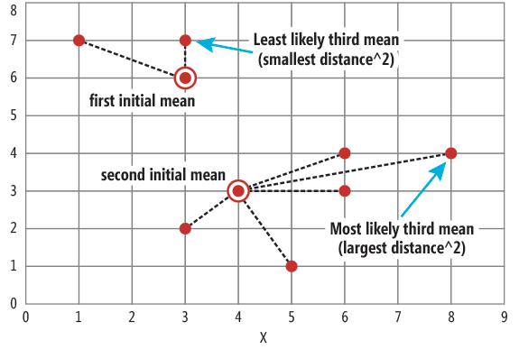
K-Means++
Smarter initialization of the centroids and improves the quality of the clustering
Select the next centroid from the data points such that the probability of choosing a point as centroid is directly proportional to its distance from the nearest, previously chosen centroid.
Point having maximum distance from the nearest centroid is most likely to be selected next as a centroid

Slide 42
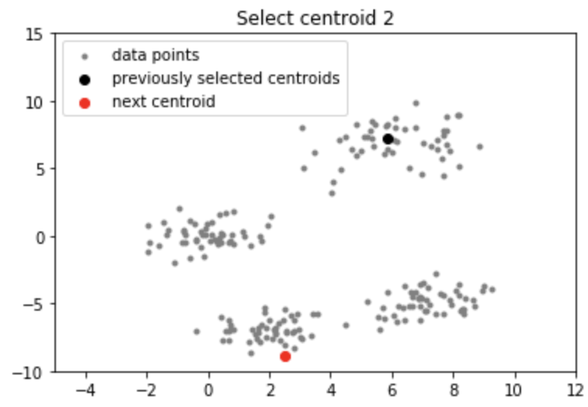
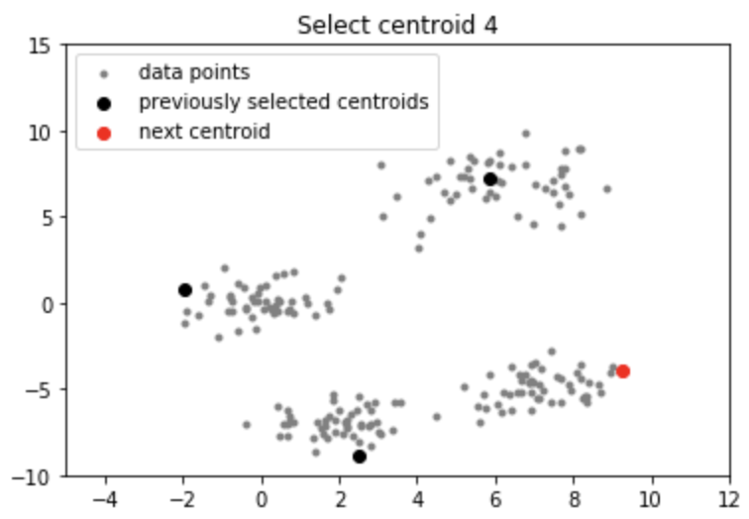

K-Means++
Randomly select the first centroid from the data points.
For each data point compute its distance from the nearest, previously chosen centroid.
Select the next centroid from the data points such that the point having maximum distance from the nearest centroid is most likely to be selected next as a centroid
Repeat steps 2 and 3 until $k$ centroids have been sampled

Slide 43
The K-Medoids Clustering Method
Find representative objects, called medoids, in clusters
PAM (Partitioning Around Medoids, 1987)
starts from an initial set of medoids and iteratively replaces one of the medoids by one of the non-medoids if it improves the total distance of the resulting clustering
PAM works effectively for small data sets, but does not scale well for large data sets

Slide 44
EM Algorithm
Initialize K cluster centers
Iterate between two steps
Expectation step: assign points to clusters
Maximation step: estimate model parameters

Slide 47
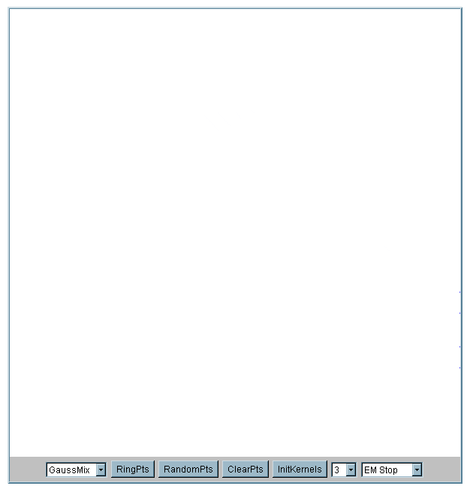
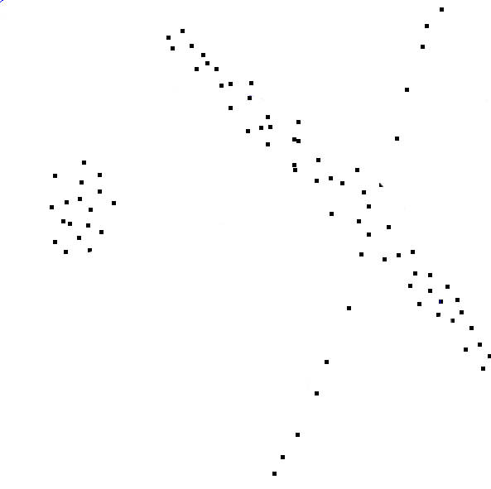

Slide 48
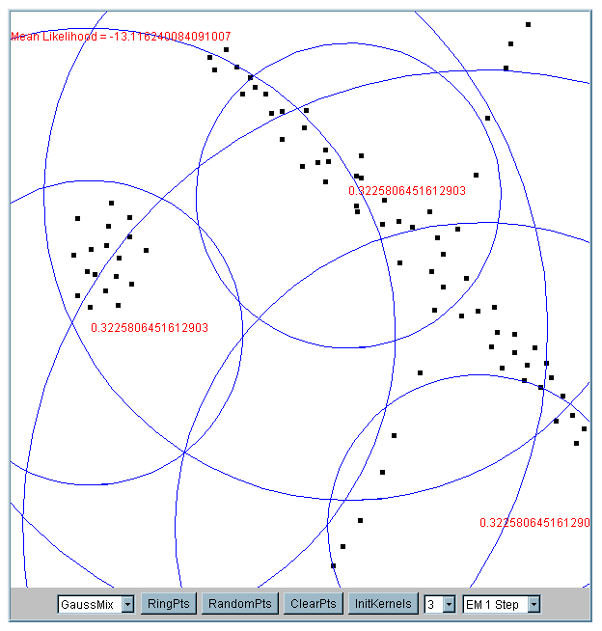
Iteration 1
The cluster means are randomly assigned

Slide 49
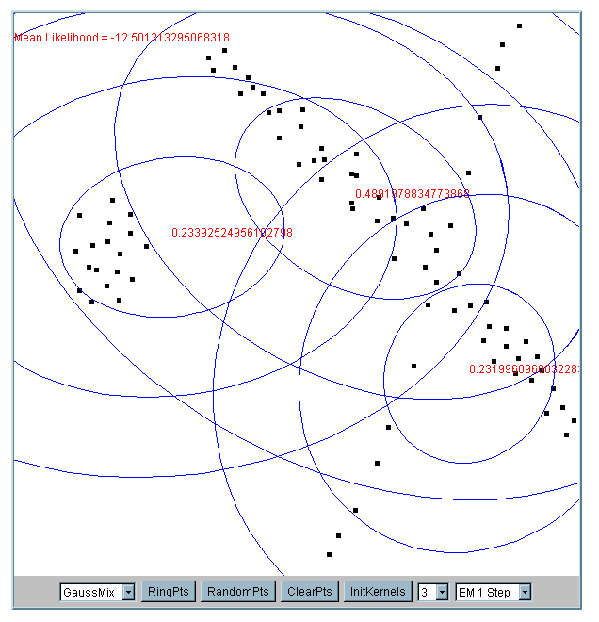
Iteration 2

Slide 50
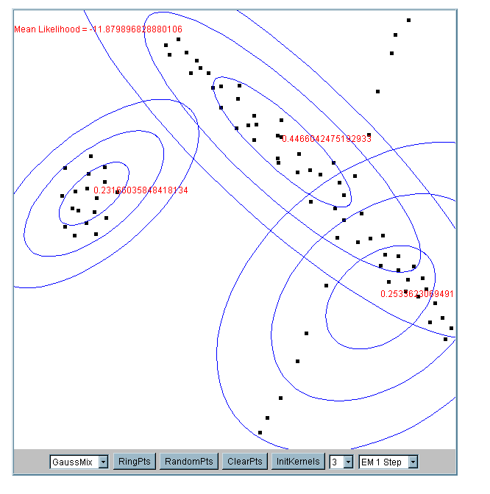
Iteration 5

Slide 51
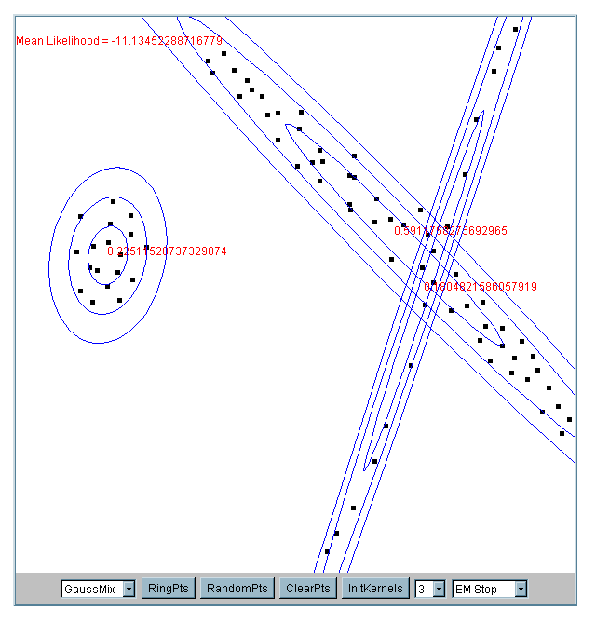
Iteration 25

Slide 52
What happens if the data is streaming…
Nearest Neighbor Clustering
Not to be confused with Nearest Neighbor Classification
Items are iteratively merged into the existing clusters that are closest.
Incremental
Threshold, t, used to determine if items are added to existing clusters or a new cluster is created.

Slide 53
10
9
8
7
Threshold t
6
5
4
3
1
t
2
1
2
1
2
3
4
5
6
7
8
9
10

Slide 54
10
9
8
7
6
New data point arrives…
It is within the threshold for cluster 1, so add it to the cluster, and update cluster center.
5
4
3
1
3
2
1
2
1
2
3
4
5
6
7
8
9
10

Slide 55
New data point arrives…
It is not within the threshold for cluster 1, so create a new cluster, and so on..
10
4
9
8
7
6
5
4
3
1
3
2
1
2
Algorithm is highly order dependent…
It is difficult to determine t in advance…
1
2
3
4
5
6
7
8
9
10

Slide 56
Partitional Clustering Algorithms
Clustering algorithms have been designed to handle very large datasets
E.g. the Birch algorithm
Main idea: use an in-memory R-tree to store points that are being clustered
Insert points one at a time into the R-tree, merging a new point with an existing cluster if is less than some δ distance away
If there are more leaf nodes than fit in memory, merge existing clusters that are close to each other
At the end of first pass we get a large number of clusters at the leaves of the R-tree
Merge clusters to reduce the number of clusters

Slide 57
Partitional Clustering Algorithms
We need to specify the number of clusters in advance, I have chosen 2
The Birch algorithm
R10
R11
R10 R11 R12
R1 R2 R3
R4 R5 R6
R7 R8 R9
R12
Data nodes containing points

Slide 58
Partitional Clustering Algorithms
The Birch algorithm
R10
R11
R10 R11 R12
{R1,R2} R3
R4 R5 R6
R7 R8 R9
R12
Data nodes containing points

Slide 59
Partitional Clustering Algorithms
The Birch algorithm
R10
R11
R12

Slide 60
How can we tell the right number of clusters?
In general, this is an unsolved problem. However, there are many approximate methods. In the next few slides, we will see an example.
10
9
For our example, we will use the familiar katydid/grasshopper dataset.
However, in this case we are imagining that we do NOT know the class labels. We are only clustering on the X and Y axis values.
8
7
6
5
4
3
2
1
1
2
3
4
5
6
7
8
9
10

Slide 61
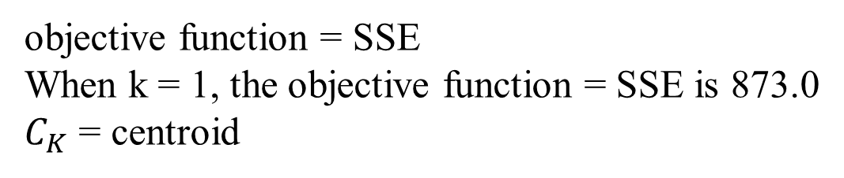
objective function = SSE
When k = 1, the objective function = SSE is 873.0
$C_{K}$ = centroid
k = # of clusters
m = # of data points in a cluster
1
2
3
4
5
6
7
8
9
10

Slide 62
When k = 2, the objective function is 173.1
1
2
3
4
5
6
7
8
9
10

Slide 63
When k = 3, the objective function is 133.6
1
2
3
4
5
6
7
8
9
10

Slide 64
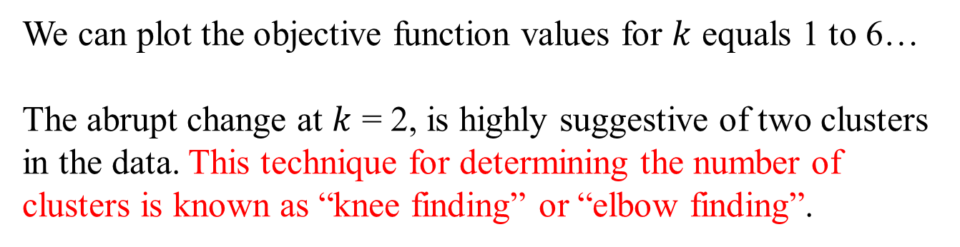
We can plot the objective function values for $k$ equals 1 to 6…
The abrupt change at $k$ = 2, is highly suggestive of two clusters in the data. This technique for determining the number of clusters is known as “knee finding” or “elbow finding”.
1.00E+03
9.00E+02
8.00E+02
7.00E+02
6.00E+02
Objective Function
5.00E+02
4.00E+02
3.00E+02
2.00E+02
1.00E+02
0.00E+00
k
1
2
3
4
5
6
Note that the results are not always as clear cut as in this toy example

Slide 65
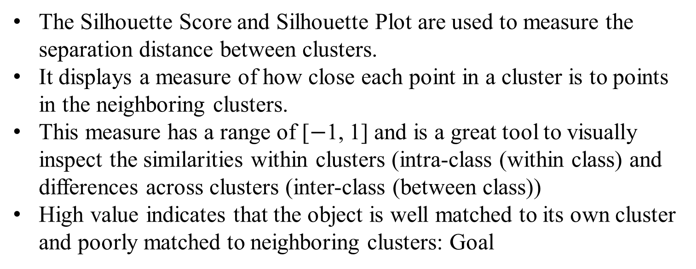
Performance Metrics: Silhouette Score
The Silhouette Score and Silhouette Plot are used to measure the separation distance between clusters.
It displays a measure of how close each point in a cluster is to points in the neighboring clusters.
This measure has a range of [$−$1, 1] and is a great tool to visually inspect the similarities within clusters (intra-class (within class) and differences across clusters (inter-class (between class))
High value indicates that the object is well matched to its own cluster and poorly matched to neighboring clusters: Goal

Slide 66
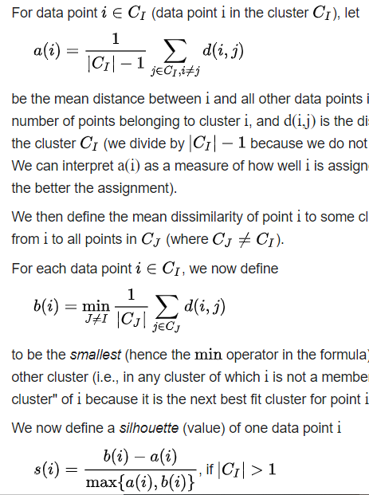
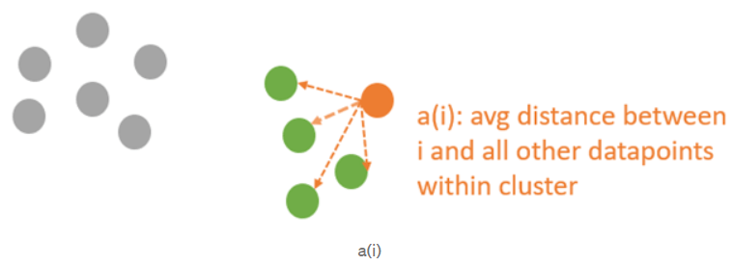
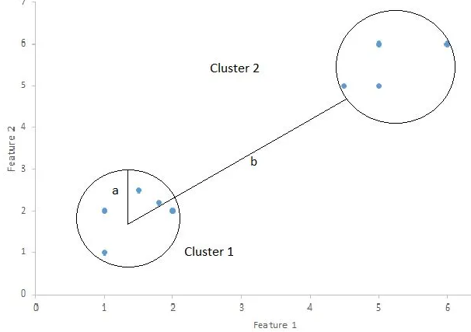
Performance Metrics: Silhouette Score
intra-class (within class): cohesion
$\left|C_{I}\right|$: number of points belongs to cluster $C_{I}$. $d\left(i,j\right)$: distance between datapoints $i$ and $j$

Slide 67
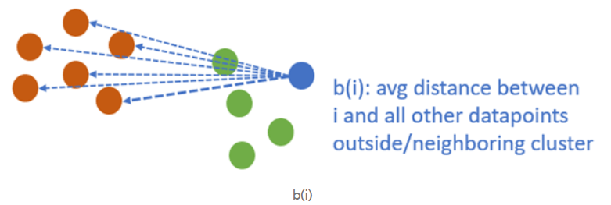

Performance Metrics: Silhouette Score
inter-class (between class): separation
Good cluster: $b_{i}>a_{i}$

Slide 68
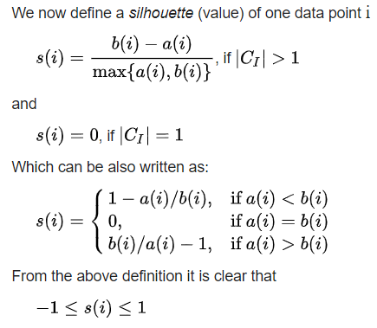
Performance Metrics: Silhouette Score

Slide 69
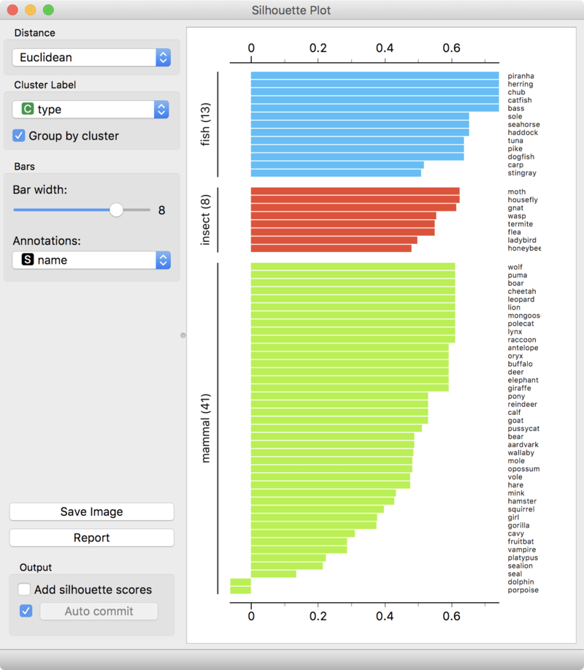
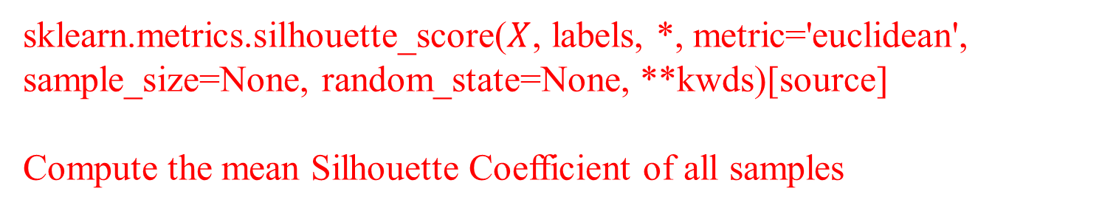
Performance Metrics: Silhouette Plot
sklearn.metrics.silhouette_score($X$, labels, *, metric='euclidean', sample_size=None, random_state=None, **kwds)[source]
Compute the mean Silhouette Coefficient of all samples

Slide 70
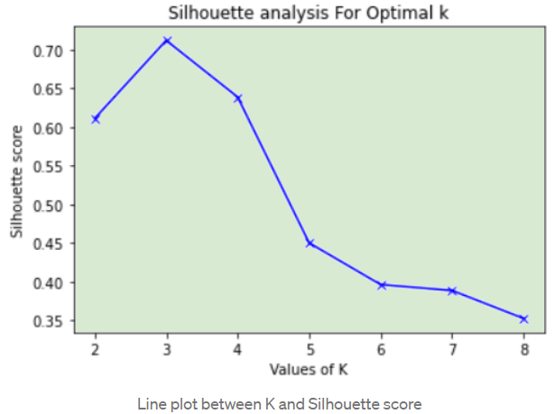
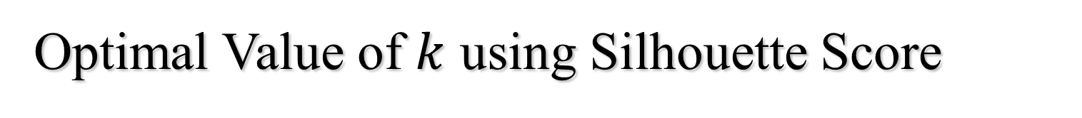
Optimal Value of $k$ using Silhouette Score
The silhouette score is highest at k=3. Hence the number of clusters i.e., the value of k should be 3.

Slide 71
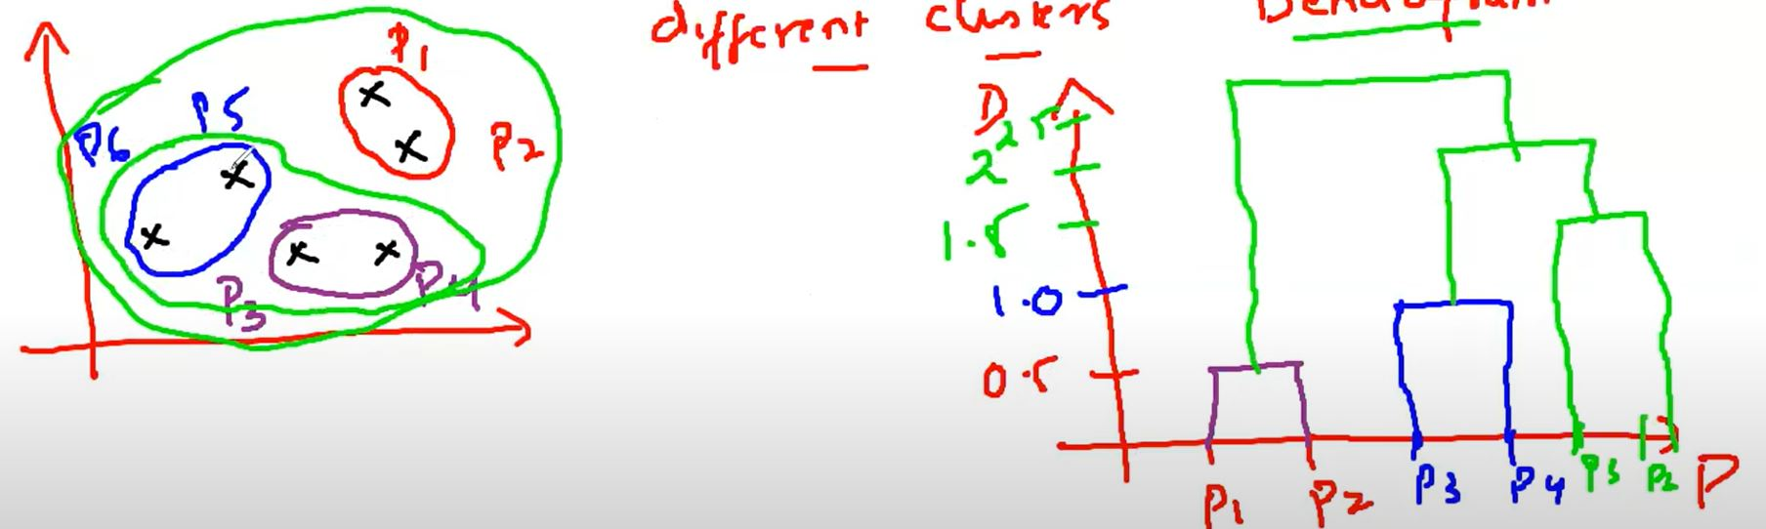
Hierarchical Clustering
Agglomerative: Agglomerative is a bottom-up approach, in which the algorithm starts with taking all data points as single clusters and merging them until one cluster is left.
Considers each dataset as a single cluster at the beginning, and then start combining the closest pair of clusters together.
It does this until all the clusters are merged into a single cluster that contains all the datasets
Agglomerative HCA
Dendrogram

Slide 72
Hierarchical Clustering: Agglomerative/ bottom-up
Make each data point a cluster
Take the two closest clusters and make them one cluster
Repeat step 2 until there is only one cluster
Agglomerative HCA
Dendrogram

Slide 73
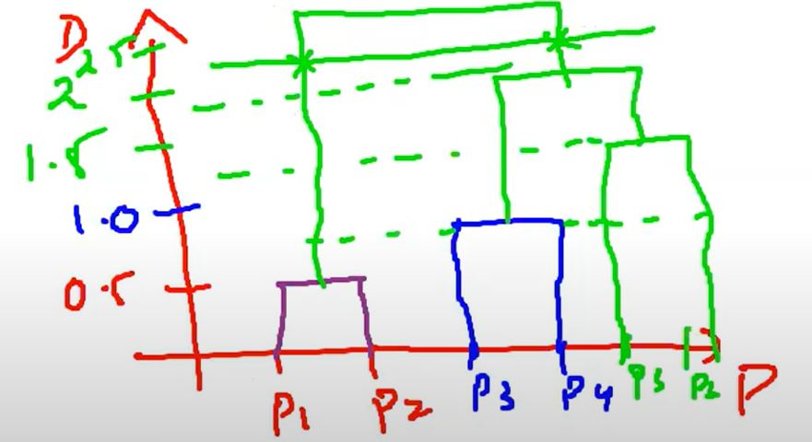
In the dendrogram locate the largest vertical difference between nodes, and in the middle pass a horizontal line.
Largest vertical line such that none of the horizontal line passes through them
The number of vertical lines intersecting it is the optimal number of clusters
Optimal number of clusters from dendrogram

Slide 74
Hierarchical Clustering
No assumption of a particular number of clusters (i.e., k-means)
May correspond to meaningful taxonomies
Once a decision is made to combine two clusters, it can’t be undone
Too slow for large data sets, O(𝑛² ×log(𝑛))
𝑛 = # of total data points
class sklearn.cluster.AgglomerativeClustering(n_clusters=2, *, affinity='deprecated', metric=None, memory=None, connectivity=None, compute_full_tree='auto', linkage='ward', distance_threshold=None, compute_distances=False)
metric = l1, l2

Slide 75
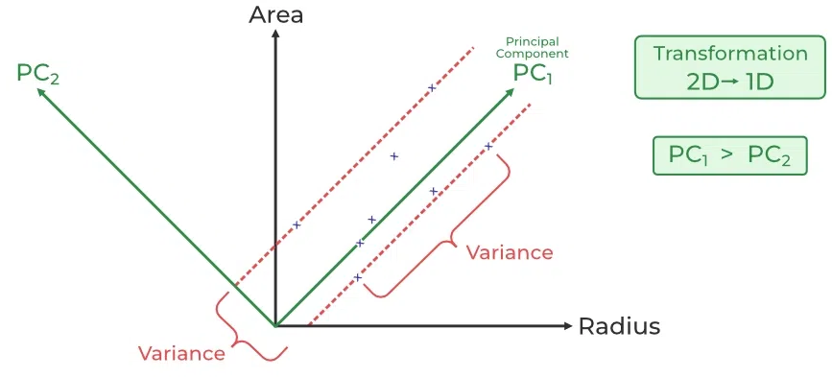
Principal Component Analysis (PCA)
Widely used technique in ML and statistics for dimensionality/feature reduction, data visualization and reduce overfitting.
Transforms data from a high-dimensional into a lower-dimensional space while retaining as much of the variance (information).
Simplify datasets with many features (variables) into fewer NEW features while maintaining the essence of the data.
The principal components are orthogonal (perpendicular) to each other and they are linearly independent
The first PC captures the most variation in the data, but the second PC captures the maximum variance that is orthogonal to the first PC

